Slide 1







“Left Behind” to Die? Mortality Gap for “Left-Behind” Regions in 11 EU Countries
Di Yang, Elias Mossialos, Ilias Kyriopoulos, Pauline Pearcy, Vassilis Karadimitris
LSE Health, London School of Economics and Political Science
lse.ac.uk/lse-health
@LSEHealthPolicy
LSE Health
Notes:
A policy impact evaluation in China
Whether expanding social health insurance can reduce self-discharge against medical advice

Slide 2



Background
“Left-behind” regions have been a prominent construct in political science and economic geography literature following the right-wing electoral shifts across the Atlantic in the past decade
For example, the red states in the Rust Belt are Trump's stronghold.
British voters in the Forgotten North had strong support for Brexit.
@LSEHealthPolicy
LSE Health

Slide 3
What are “left-behind” regions?
Economic geography literature characterized “left-behind” regions as post-industrial or rural regions marginalized by globalization, the accompanied labor market restructuring, and economic decline.
Structural factors, such as globalization, the rise of the service and knowledge economy, and demographic shift, can have spatially uneven impacts at the sub-national level, which inevitably led to divergent regional development outcomes and exacerbated spatial inequality.
@LSEHealthPolicy
LSE Health

Slide 4
“Left-behind” typologies
We followed the established “left-behind” typologies in the economic geography literature and categorized EU regions into six clusters at the NUTS 3 level:
Long-term economic prosperity
high growth
relative economic and demographic stability
economic decline and deindustrialization
demographic decline and ageing
disconnected, high poverty
The former three typologies were not considered as “left-behind”, while the latter three were considered “left-behind” regions.
@LSEHealthPolicy
LSE Health

Slide 5
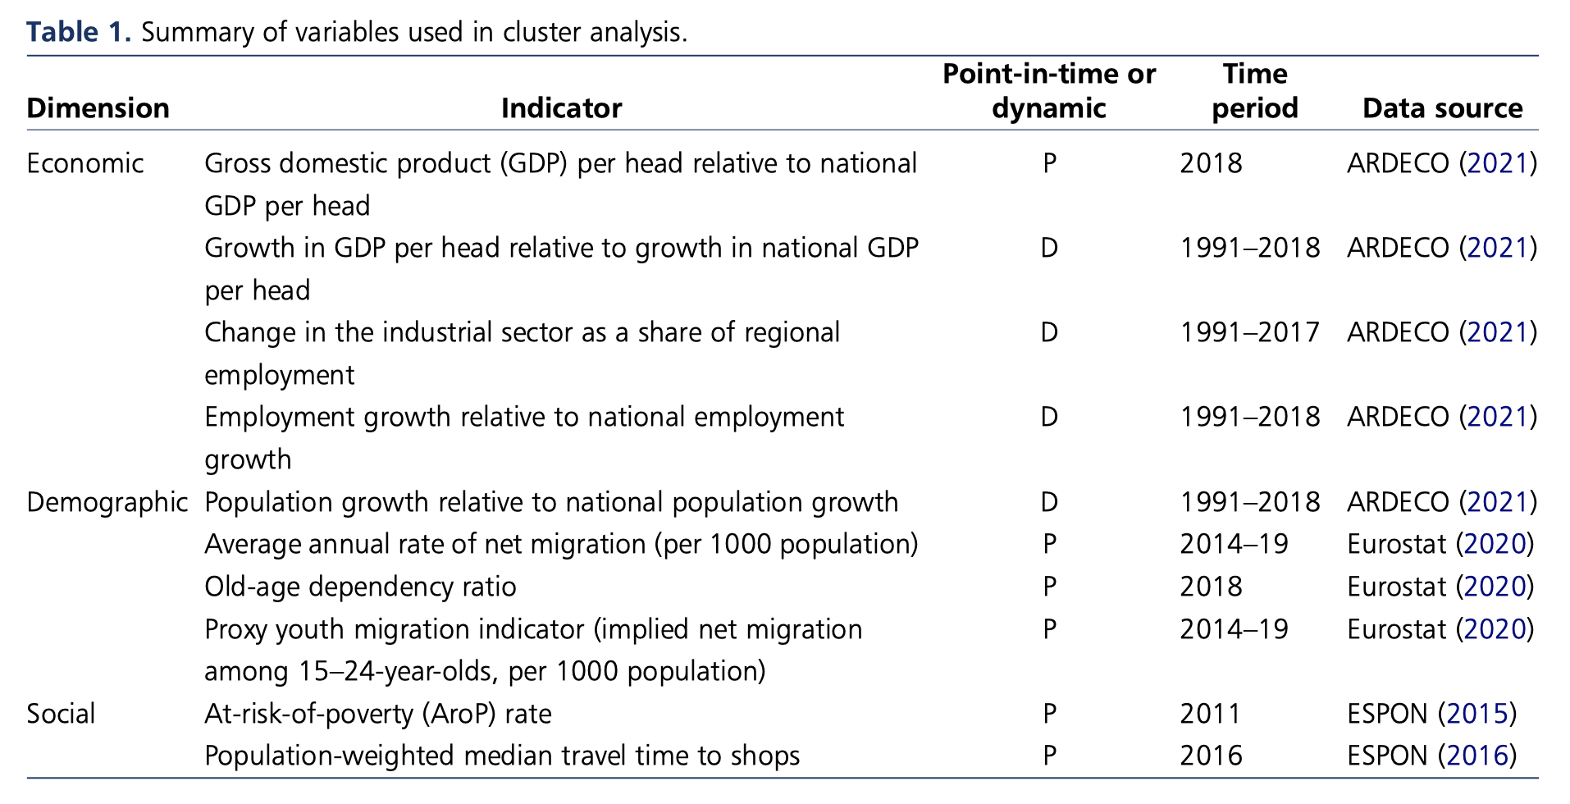

Slide 6
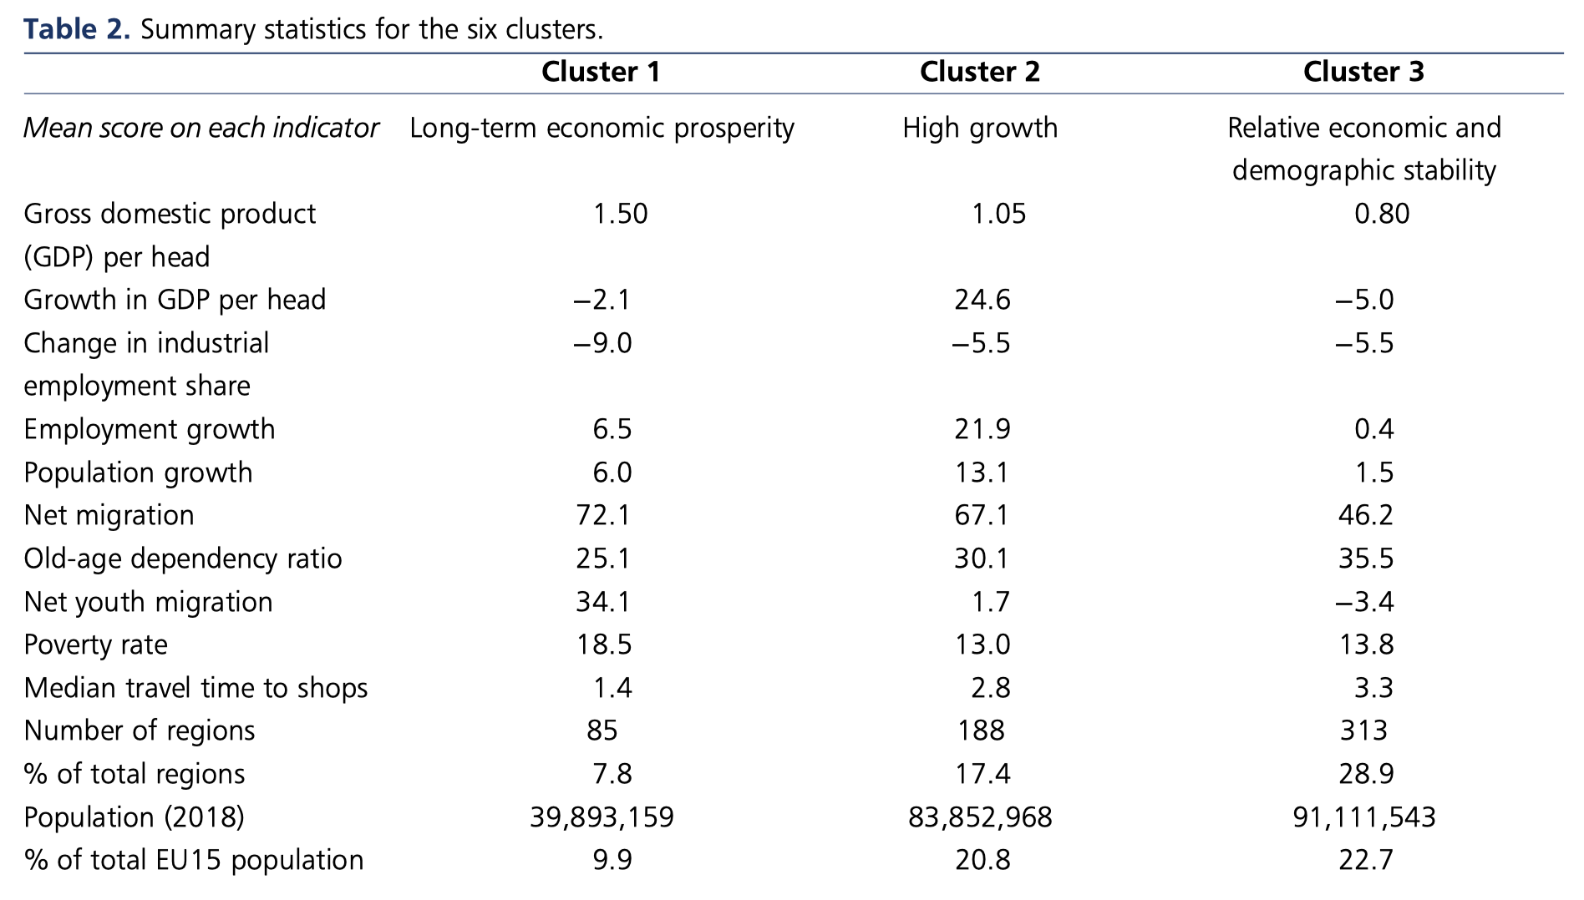
Notes:
Average per capita output exceeds the national level only in cluster 1 and, marginally, in cluster 2, with the remaining clusters exhibiting lower levels. Cluster 1, in particular, with its very high per capita GDP and its mostly urban nature, reflects the tendency for economic activity to spatially concentrate due to agglomeration economies
while regions in cluster 1 start off with some of the highest relative levels of per capita output, they tend to see little growth. In contrast, cluster 2 starts from a lower base but has the highest average relative growth rate across all the clusters. Rather than being easily accounted for by general processes such as agglomeration or convergence/divergence, these distinct economic trajectories can be better explained through endogenous aspects such as innovation and the development of new growth paths, as well as policy and institutional factors
Although cluster 3 exhibits less evdence of high per capita output or growth, taken overall, it does not fit the description ‘left behind’ either, as most of the regions in this cluster did not experience substantial economic or demographic decline over the past four decades, and rates of poverty are generally low.

Slide 7
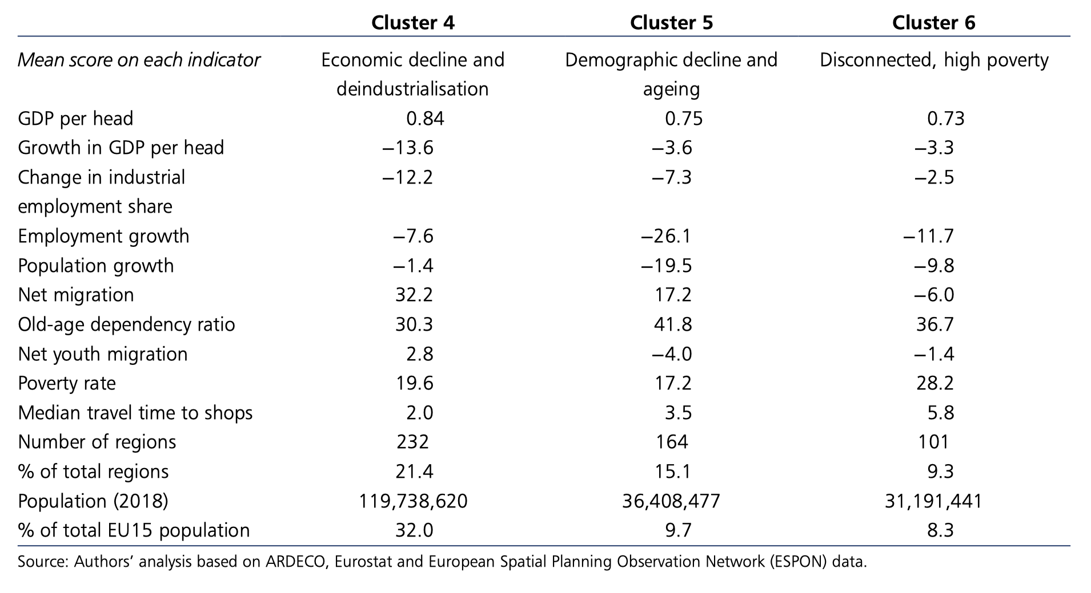

Slide 8
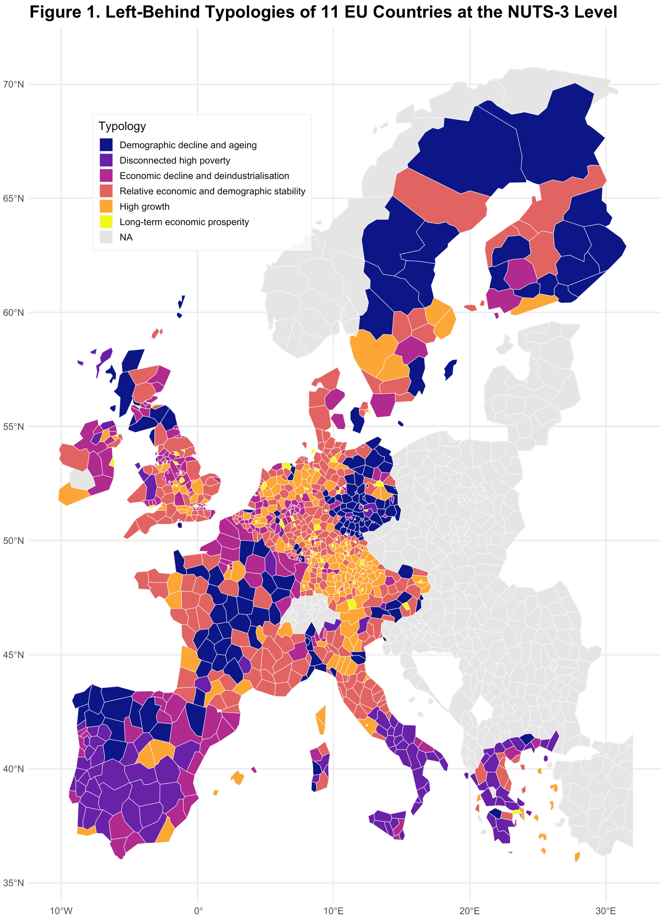
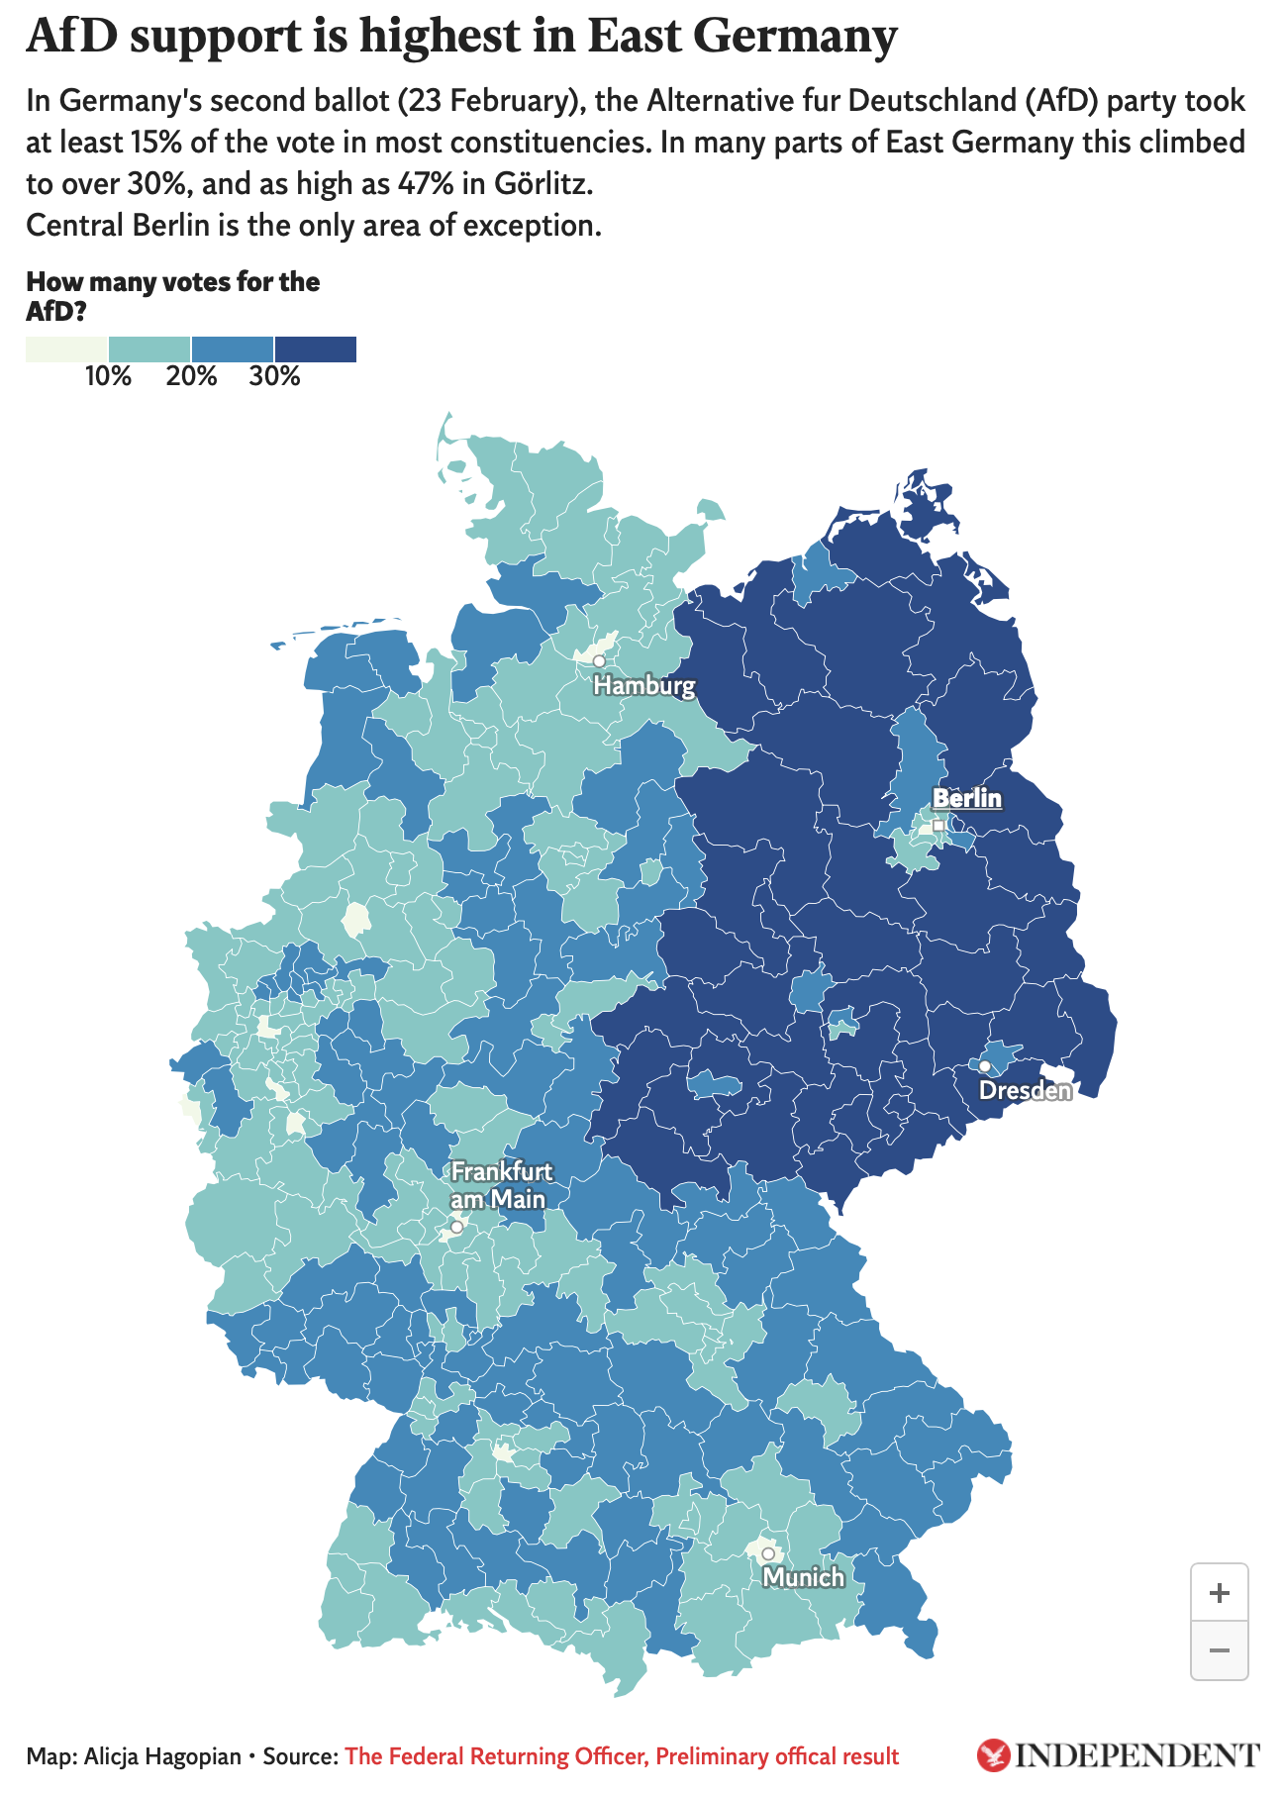

Slide 9
”Left-behind” regions and mortality
“Left-behindness” is like an expanded version of socioeconomic determinants of health, with a spatial dimension
Many studies examined spatial health inequality in the EU, but few studies linked health or mortality outcomes to “left-behindness”
Our study leverages the construct of “left-behind” regions in political science and economic geography literature, and evaluates mortality gradient across various “left-behind” typologies
@LSEHealthPolicy
LSE Health

Slide 10
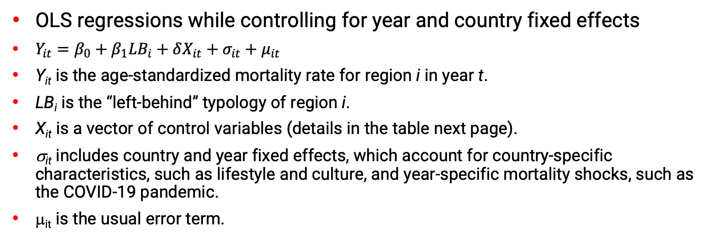
Methods
OLS regressions while controlling for year and country fixed effects
$\begin{aligned}\begin{aligned}Y_{it}=β_{0}+β_{1}{LB}_{i}+δX_{it}+σ_{it}+μ_{it} \end{aligned}\end{aligned}$
Y_{it} is the age-standardized mortality rate for region i in year t.
LB_{i} is the “left-behind” typology of region i.
X_{it} is a vector of control variables (details in the table next page).
σ_{it} includes country and year fixed effects, which account for country-specific characteristics, such as lifestyle and culture, and year-specific mortality shocks, such as the COVID-19 pandemic.
μ_{it} is the usual error term.
@LSEHealthPolicy
LSE Health

Slide 11
Factor | Demographic decline and ageing | Disconnected high poverty | Economic decline and deindustrialisation | High growth | Long-term economic prosperity | Relative economic and demographic stability
Overall age-standardized mortality rate | 1041.59 (140.86) | 984.33 (105.27) | 1013.79 (137.34) | 985.00 (108.11) | 1031.66 (106.29) | 1001.42 (117.69)
Male age-standardized mortality rate | 1309.68 (179.51) | 1210.83 (123.90) | 1254.43 (172.95) | 1193.46 (131.34) | 1263.68 (144.73) | 1218.58 (137.55)
Female age-standardized mortality rate | 834.96 (122.21) | 801.94 (96.63) | 832.76 (121.71) | 821.64 (95.22) | 856.93 (86.06) | 832.57 (108.20)
Education attainment | 83.82 (9.37) | 63.72 (11.56) | 77.18 (10.10) | 81.49 (6.81) | 82.62 (3.64) | 80.45 (6.59)
Crime rate | 371.82 (210.32) | 165.79 (98.29) | 406.06 (259.94) | 466.58 (277.98) | 864.47 (525.14) | 390.54 (214.89)
Cooling degree day index | 73.12 (95.32) | 367.42 (181.36) | 118.12 (167.38) | 90.44 (145.43) | 44.33 (32.38) | 100.94 (141.30)
Heating degree day index | 2773.41 (954.56) | 1488.03 (677.14) | 2209.72 (656.77) | 2519.53 (638.29) | 2560.85 (310.29) | 2505.78 (676.55)
Number of physicians per 100,000 people | 275.53 (135.36) | 443.14 (123.96) | 288.99 (149.92) | 229.34 (146.98) | 255.68 (118.48) | 277.21 (156.78)
Number of hospital beds per 100,000 people | 514.83 (250.56) | 340.42 (124.72) | 531.02 (257.93) | 430.14 (305.01) | 1029.96 (447.01) | 460.60 (215.55)
PM2.5 | 7.39 (2.39) | 7.58 (5.43) | 8.96 (2.16) | 8.49 (2.32) | 9.02 (1.17) | 8.16 (2.56)
N | 144 | 92 | 144 | 166 | 62 | 262
Notes: Standard deviations are reported in brackets.

Slide 12
 | mortality | male mortality | female mortality
Left-behind typology
High growth (reference)
Long-term economic prosperity | -19.518*** | -21.722** | -15.510***
 | (5.629) | (8.032) | (4.657)
Relative economic and demographic stability | 40.807*** | 56.236*** | 28.252***
 | (2.601) | (3.691) | (2.217)
Economic decline and deindustrialisation | 53.508*** | 77.521*** | 38.844***
 | (3.348) | (4.718) | (2.827)
Demographic decline and ageing | 96.066*** | 143.928*** | 59.754***
 | (2.860) | (4.192) | (2.472)
Disconnected high poverty | 65.716*** | 94.786*** | 40.099***
 | (4.551) | (6.117) | (4.104)
Education attainment | -3.523*** | -2.749*** | -3.983***
 | (0.259) | (0.348) | (0.230)
Crime rate | 0.039*** | 0.065*** | 0.028***
 | (0.007) | (0.010) | (0.006)
Cooling degree day index | 0.190*** | 0.191*** | 0.180***
 | (0.014) | (0.018) | (0.013)
Heating degree day index | 0.021*** | 0.026*** | 0.018***
 | (0.003) | (0.003) | (0.002)
Number of physicians per 100,000 people | -0.008 | -0.043 | 0.030
 | (0.027) | (0.035) | (0.024)
Number of hospital beds per 100,000 people | 0.012** | 0.030*** | 0.002
 | (0.005) | (0.007) | (0.004)
PM2.5 | 2.503*** | 4.034*** | 1.800***
 | (0.599) | (0.881) | (0.473)
N | 5919 | 5919 | 5919
* p<0.05, *** p<0.01, *** p<0.001
Ranking from the lowest to the highest mortality rates are
long-term economic prosperity,
high growth,
relative economic and demographic stability,
economic decline and deindustrialization,
disconnected high poverty,
demographic decline and ageing.
The worst performing typologies are all considered as “left-behind” regions

Slide 13
Findings
We found a clear mortality gradient across the six “left-behind” typologies.
This mortality gradient is consistent for overall, male, and female age-standardized mortality rates.
The gap in age-standardized mortality rate between the best and worst performing typologies is 115.58 deaths per 100,000 population per year (more than 10% mortality difference).
The male and female differences in age-standardized mortality rate are 165.65 and 75.26 deaths per 100,000 population per year, respectively.
@LSEHealthPolicy
LSE Health

Slide 14
 | mortality | male mortality | female mortality
Left-behind typology
High growth (reference)
Long-term economic prosperity | -18.804*** | -20.867** | -14.902**
 | (5.682) | (8.082) | (4.705)
Relative economic and demographic stability | 41.115*** | 56.470*** | 28.584***
 | (2.629) | (3.713) | (2.245)
Economic decline and deindustrialisation | 54.013*** | 78.052*** | 39.309***
 | (3.392) | (4.761) | (2.867)
Demographic decline and ageing | 96.670*** | 144.439*** | 60.378***
 | (2.899) | (4.224) | (2.507)
Disconnected high poverty | 64.990*** | 93.905*** | 39.503***
 | (4.568) | (6.121) | (4.128)
Education attainment | -3.485*** | -2.730*** | -3.932***
 | (0.259) | (0.348) | (0.230)
Crime rate | 0.039*** | 0.064*** | 0.028***
 | (0.007) | (0.010) | (0.006)
Cooling degree day index | 0.212*** | 0.212*** | 0.201***
 | (0.013) | (0.017) | (0.012)
Heating degree day index | 0.023*** | 0.028*** | 0.020***
 | (0.002) | (0.003) | (0.002)
Number of physicians per 100,000 people | -0.010 | -0.046 | 0.029
 | (0.027) | (0.034) | (0.024)
Number of hospital beds per 100,000 people | 0.012** | 0.030*** | 0.002
 | (0.005) | (0.007) | (0.004)
PM2.5 | 2.556*** | 4.041*** | 1.872***
 | (0.587) | (0.859) | (0.466)
Year | -6.177*** | -10.205*** | -4.330***
 | (0.644) | (0.900) | (0.553)
Pandemic | 75.796*** | 100.725*** | 59.600***
 | (3.796) | (5.107) | (3.274)
N | 5919 | 5919 | 5919
* p<0.05, *** p<0.01, *** p<0.001
Robustness Check using different regression specification: remove year fixed effect, add year (continuous variable) and pandemic (dummy variable)
The results are consistent with the main analysis
The COVID-19 pandemic is associated with 75.80 more deaths per 100,000 population per year, despite an annual trend of 6.18 fewer deaths per 100,000 population per year.

Slide 15
Auxiliary analysis:
Mortality differential of the COVID-19 pandemic across the ”left-behind” typologies
We added an interaction term of the pandemic dummy and “left-behind” typologies
LSE Health

Slide 16
 | mortality | male mortality | female mortality
Left-behind typology
Demographic decline and ageing (reference)
Long-term economic prosperity | -118.236*** | -170.491*** | -76.384***
 | (5.882) | (8.316) | (4.988)
High growth | -98.995*** | -148.771*** | -61.272***
 | (3.117) | (4.623) | (2.697)
Relative economic and demographic stability | -58.705*** | -93.756*** | -32.793***
 | (2.778) | (4.031) | (2.439)
Economic decline and deindustrialisation | -47.698*** | -73.094*** | -24.681***
 | (3.647) | (5.186) | (3.164)
Disconnected high poverty | -37.579*** | -57.864*** | -25.555***
 | (4.876) | (6.644) | (4.462)
Pandemic | 62.925*** | 80.382*** | 52.584***
 | (5.407) | (7.421) | (4.677)
Left-behind typology * pandemic
Demographic decline and ageing * pandemic (reference)
Long-term economic prosperity * pandemic | 9.541 | 29.723 | -1.811
 | (21.965) | (31.618) | (16.082)
Relative economic and demographic stability * pandemic | 13.414* | 25.110** | 3.947
 | (6.757) | (9.119) | (5.769)
Economic decline and deindustrialisation * pandemic | 21.373** | 28.402* | 15.443*
 | (8.076) | (11.024) | (6.829)
High growth * pandemic | 9.296 | 18.633 | 3.034
 | (7.456) | (10.054) | (6.579)
Disconnected high poverty * pandemic | 20.998* | 27.240* | 15.842*
 | (8.603) | (11.004) | (7.720)
Different from the main analysis, in terms of the COVID-19 pandemic mortality, the best-performing typology is demographic decline and ageing, while the worst-performing typology is economic decline and deindustrialization
Both the best and worst performing typologies are considered ”left-behind” regions, which suggests heterogeneity in “left-behind” regions

Slide 17
Discussion
Prevailing narratives in media and academic literature have predominantly attributed regional political discontent to economic stagnation and demographic decline.
We found a significant mortality gradient across the established “left-behind” typologies. “Left-behind” regions exhibit systematically higher age-standardized mortality rate than non-“left-behind” regions.
The mortality gradient is consistent for overall, female, and male mortality, and robust across different regression specifications
The age-standardized mortality gap between the best and worst performing typologies reaches 115.58 deaths per 100,000 population per year, a 10% mortality gap
LSE Health

Slide 18
Discussion
Ranking from the lowest to the highest mortality rates are
long-term economic prosperity,
high growth,
relative economic and demographic stability,
economic decline and deindustrialization,
disconnected high poverty,
demographic decline and ageing.
Our findings call for integrated policy interventions to support “left-behind” regions, positioning population health as a key dimension, in addition to social, economic, and industrial policies.
LSE Health

Slide 19
Discussion
Our analysis uncovers substantial heterogeneity in pandemic mortality among 'left-behind' regions, challenging the stereotypical homogeneous portrayal of “left-behind” regions
One typology of “left-behind” regions (demographic decline and ageing) scored the lowest pandemic mortality, and better than all three typologies that are not considered “left-behind”.
Meanwhile, the other two typologies of “left-behind” regions persistently score the worst pandemic mortality.
This mortality divergence highlights the need for tailored policy design grounded in local characteristics to improve population health in “left-behind” regions.
LSE Health

Slide 20
Limitations and directions for future studies
The findings are not causal and only imply correlation.
Data limitations: some of the control variables are only available at NUTS 2 level. We also have to drop a few EU countries due to the lack of data
Spatial auto-correlation: neighbors of left-behind regions are also likely to be left-behind
Premature mortality could be a better variable to measure population health outcome
LSE Health

Slide 21
Acknowledgement
We are grateful to Dr. Michael Mühlichen for providing the German mortality data and contextual variables essential to this research.
LSE Health

